Slide 1

Short-Term Bitcoin Price Prediction
Utilizing LSTM Neural Networks
Submitted By: NITESH, MSc. Data Science

Slide 2




Core Objective: Forecasting the "Close" Price
Primary Goal
Data Preparation
Design, implement, and evaluate a short-term Bitcoin price prediction system using LSTM networks, focusing on forecasting the closing price ("close") as the target variable.
Collect and preprocess historical Bitcoin market data, handling missing values, outliers, and normalizing attributes for model compatibility.
Exploratory Analysis (EDA)
Model Evaluation
Conduct in-depth EDA to uncover meaningful insights, patterns, and interrelationships among key financial features and volatility.
Evaluate performance using statistical metrics (RMSE, MAE, R²) and visualization-based assessments comparing actual vs. predicted values.

Slide 3


Dataset: High-Granularity Market Data
The study uses comprehensive Bitcoin market data for the year 2017, sourced from Kaggle. The dataset contains approximately 525,599 rows recorded at minute-level intervals.
Key Attributes
unix / date: Timestamp and calendar date.
This high-frequency data captures the dynamic microstructure of the Bitcoin market, providing a strong empirical foundation for advanced LSTM-based sequence modeling.
symbol: Identifier (BTCUSD).
open, high, low, close: Price metrics (Close is the target variable).
Volume BTC / Volume USD: Total trading volume in Bitcoin and U.S. dollars.
Data preprocessing included Min-Max scaling for normalization and organization into an SQLite database for efficient retrieval.

Slide 4

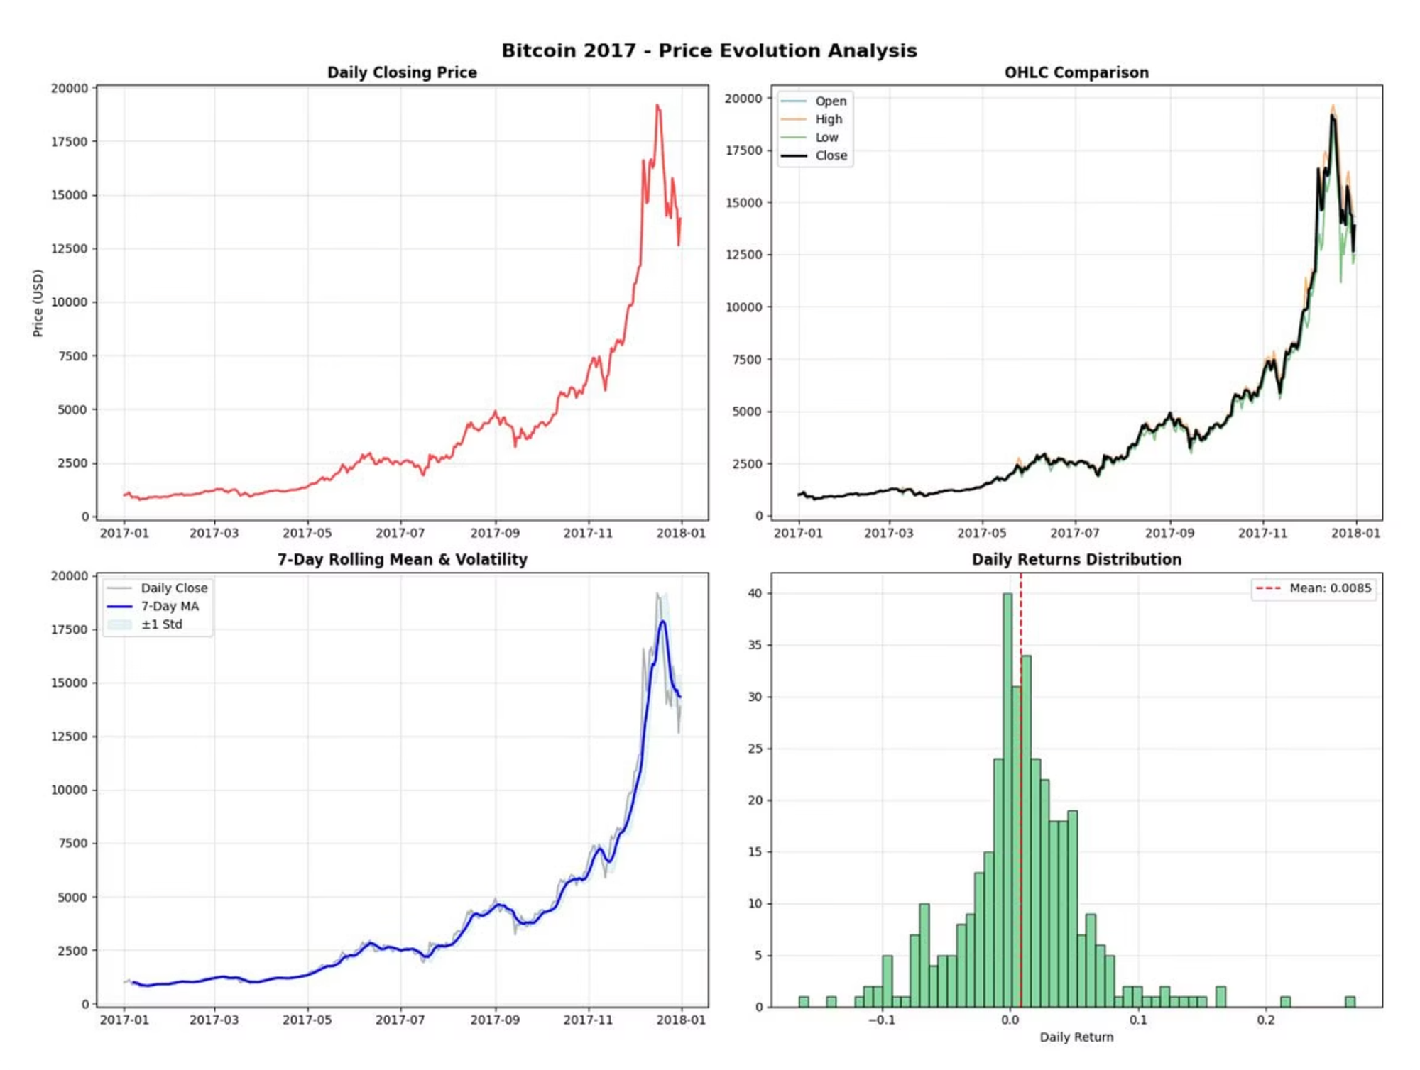
EDA: The Parabolic Bull Run of 2017
Exponential Growth
Price surged from under $1,000 to a peak near $20,000 by mid-December, followed by a sharp correction.
Exploding Volatility
Intraday price swings increased massively in the latter half of the year, confirmed by widening 7-day rolling volatility bands.
High Daily Returns
Mean daily return was 0.85%, but the distribution showed "fat tails," indicating frequent extreme gains or losses.

Slide 5
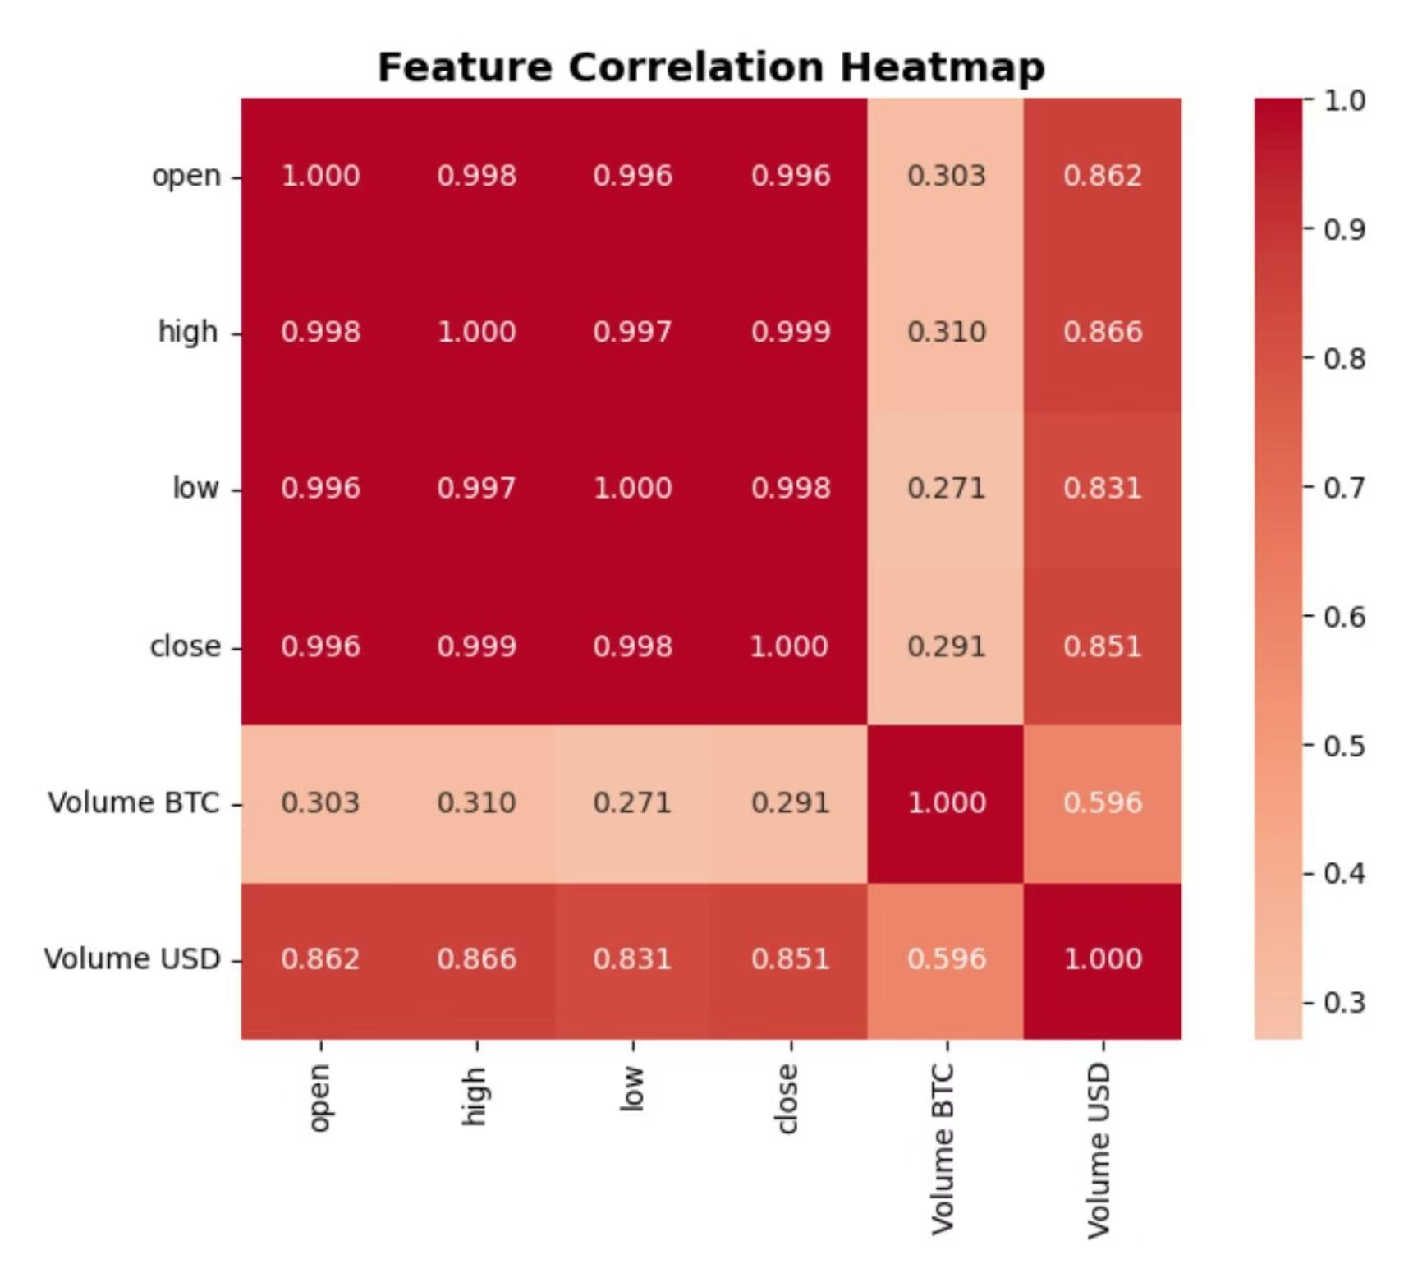
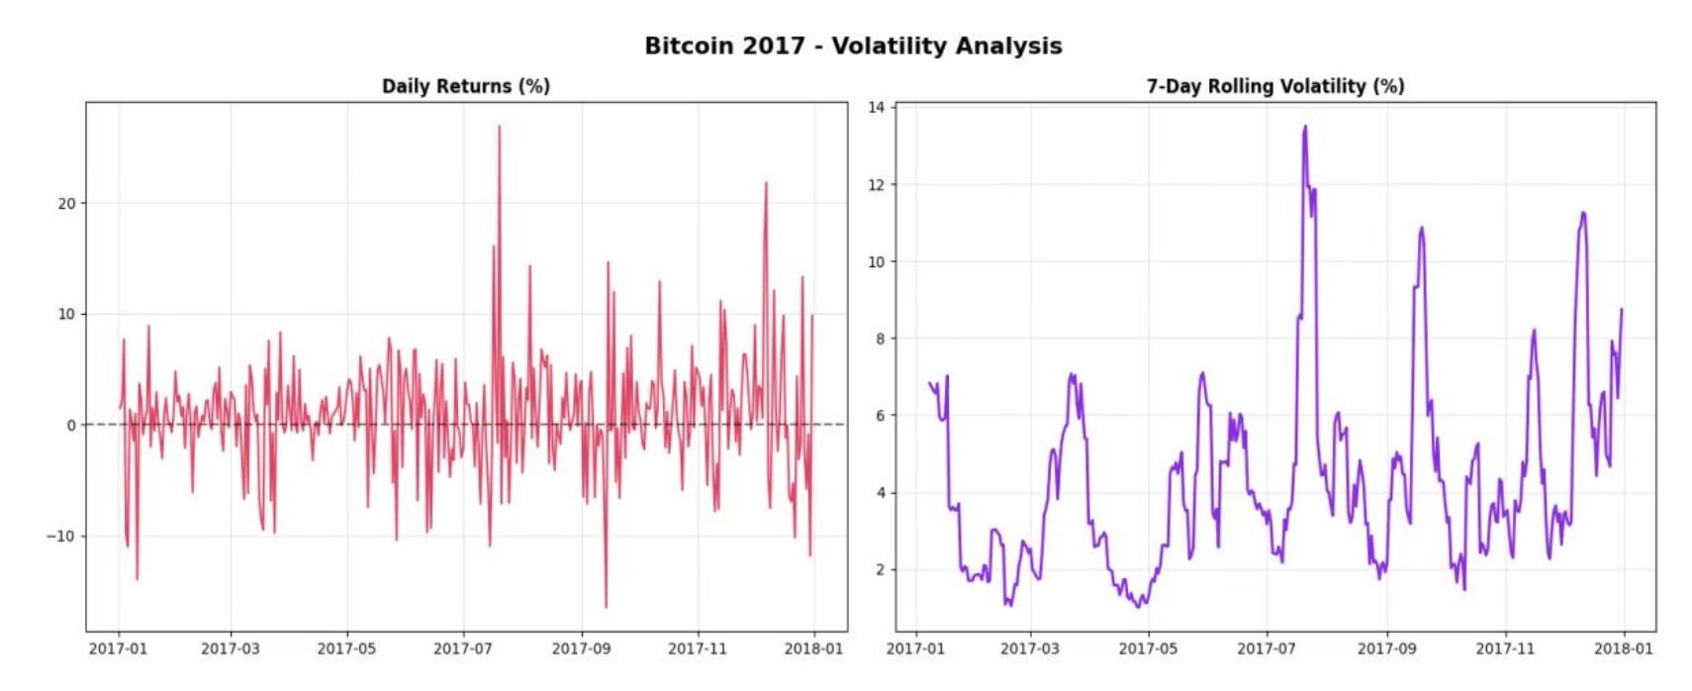
EDA: Correlation and Volatility Analysis
Feature Correlation Heatmap
Daily Volatility
Daily returns show numerous spikes, with some days exceeding 10% swings. 7-day rolling volatility peaked near 14% during the late 2017 price run-up, highlighting massive market instability.
Open, high, low, and close prices are almost perfectly correlated (near 1.0). Price and Volume USD show a strong positive correlation, while price and Volume BTC correlation is much weaker.

Slide 6




Methodology: LSTM Model Design
The project followed the CRISP-DM framework, focusing on robust data preparation and a specialized deep learning architecture.
Data Preprocessing
Training & Validation
Model Design
Data Preprocessing
Model Architecture (Keras/TensorFlow)
Training & Validation
Data was normalized (MinMaxScaler) and segmented into sequences (e.g., 30 time steps) to create 3D input compatible with LSTM architecture.
Comprised an input layer, a hidden LSTM layer (32 units), a Dropout layer (0.2), a dense layer (16 neurons, ReLU), and a final dense output layer (1 neuron).
Data split 80:20. Trained over 25 epochs with Adam optimizer and Mean Squared Error (MSE) loss. EarlyStopping was used to prevent overfitting.

Slide 7
Key Findings: Exceptional Predictive Accuracy
0.941
432.41
347.14
R² Score
RMSE
MAE
The model explained over 94% of the variance in observed closing prices, validating the LSTM's effectiveness.
Root Mean Squared Error, indicating the model's overall deviation from actual values was within a practical margin.
Mean Absolute Error, further emphasizing the model's robustness in short-term prediction.
The visual comparison showed the prediction line closely followed actual values, successfully capturing the overall market trend. This validates the superiority of LSTM architectures for time-dependent financial forecasting.

Slide 8
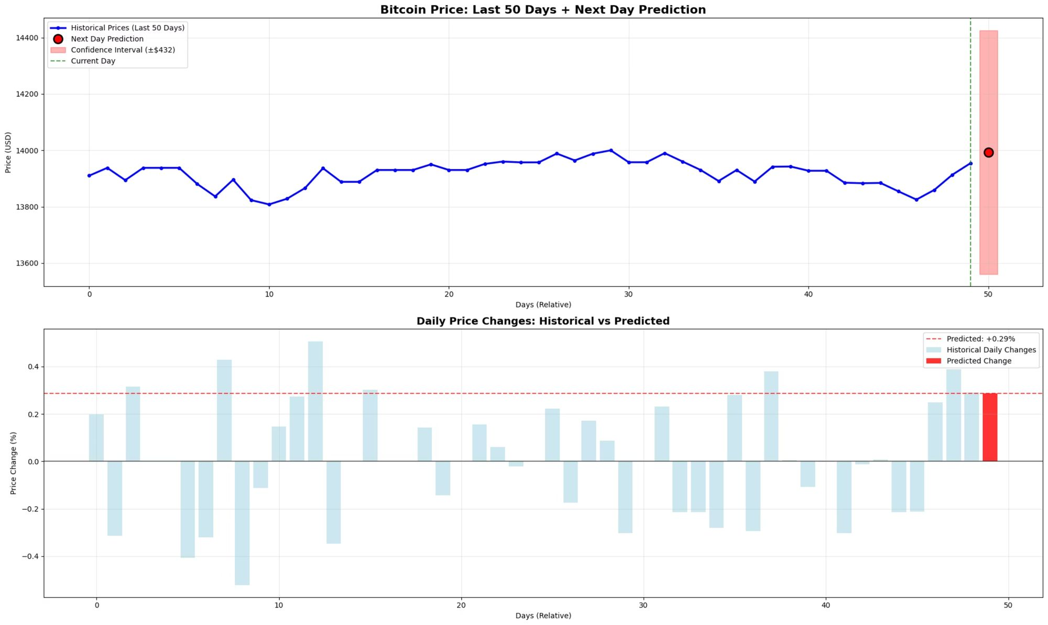
Prediction of the next day based on past 50 days

Slide 9
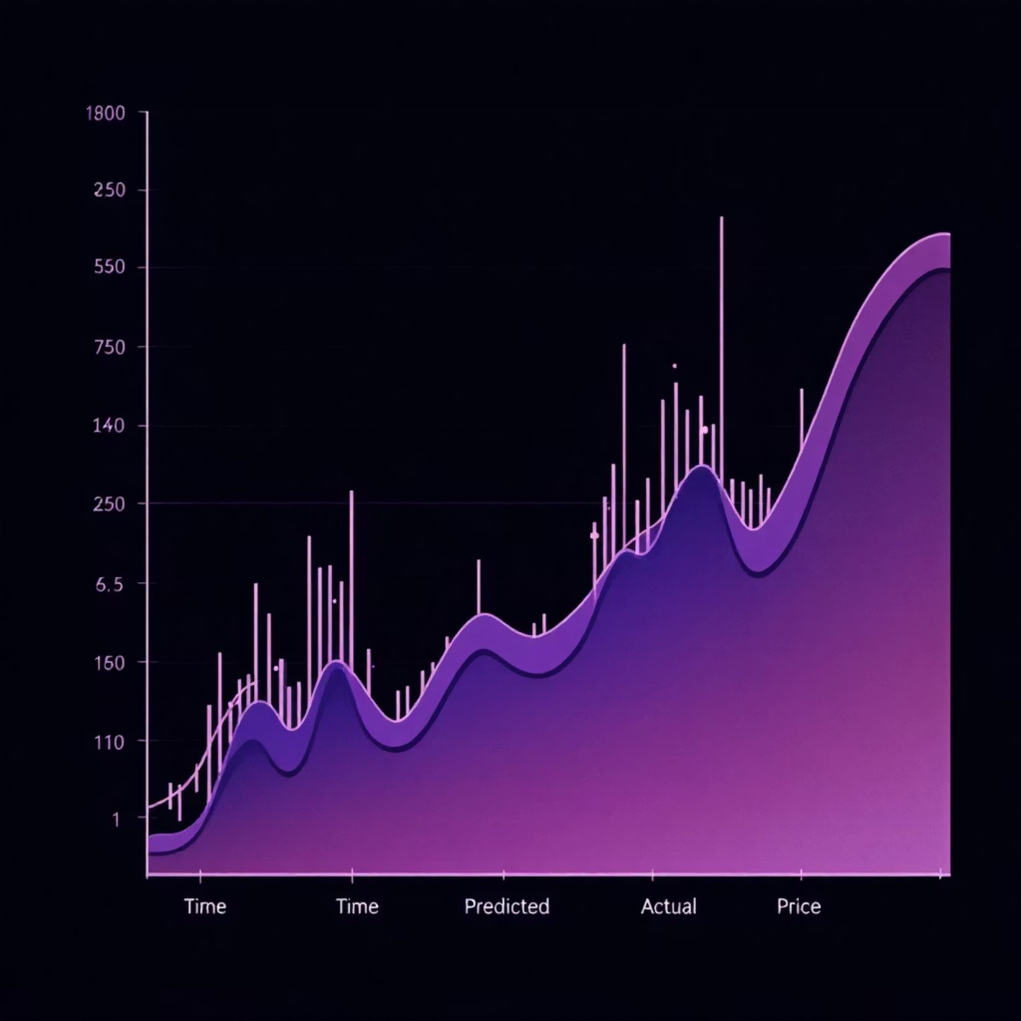

Observation and Future Enhancements
Observed Deviations
The model showed minor deviations during periods of high market volatility, where predicted prices slightly lagged behind sudden shifts. These fluctuations were limited and did not significantly affect the overall predictive accuracy.
Optimization Strategies
Fine-tune parameters (sequence length, dropout rate) to stabilize predictions.
Integrate sentiment-derived features for enhanced responsiveness to market sentiment.

Slide 10







Conclusion:
The project successfully demonstrated the application of advanced data science techniques for short-term Bitcoin price forecasting, achieving high accuracy and reliability.
Data Mining
AI (LSTM)
Multivariate Data Analysis
Big Data Analytics
This work underscores the transformative potential of combining statistical rigor, computational intelligence, and data-driven modeling in shaping the future of financial forecasting and decision-making.

Slide 11

Thank You
nitesh

